Slide 1
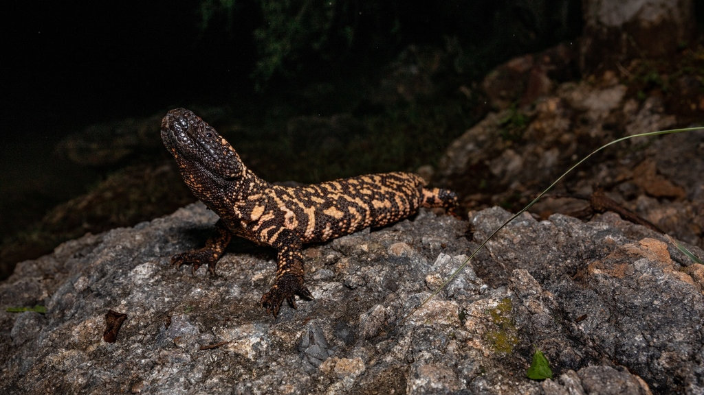


Road Impacts on Gila Monsters in an Urbanizing Environment
Samantha Johnson^{1,2} and Matt Goode¹
¹ School of Natural Resources and the Environment, University of Arizona
² School of Animal and Comparative Biomedical Sciences, University of Arizona
Notes:
Add logos

Slide 2
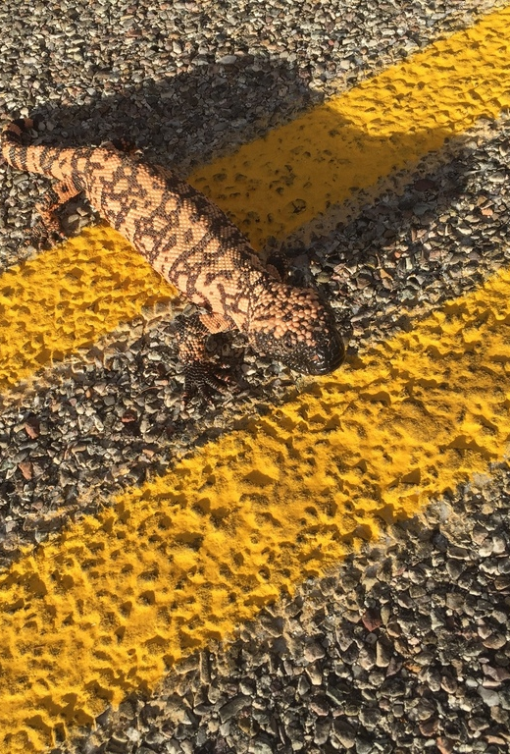


Herpetofauna (Reptile and Amphibian) Road Use
Reasons for crossing
Crossing road to another part of the habitat
Thermoregulation
Migration
Searching for food
Herpetofauna most effected by roads
Slow-moving, thermoregulating, scavenging, and large home range animals
Notes:
2-6 slides need to be compressed into 1-2 slides max; bullet slides 4-6 (cite)

Slide 3
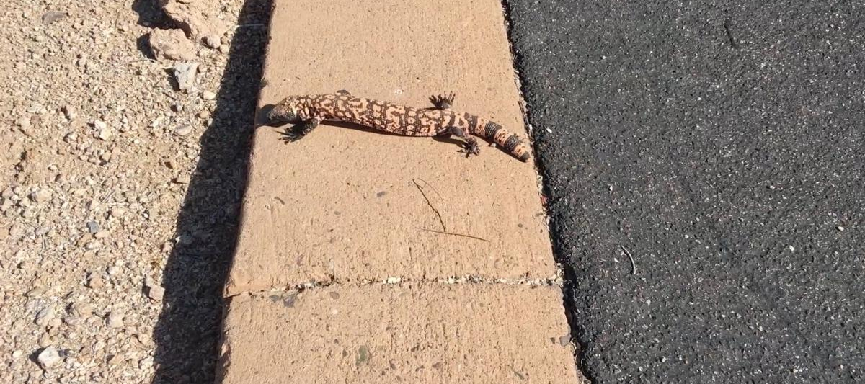


Indirect Impacts
Direct Impacts
Effects that involve the reduction of landscape, habitat fragmentation, and behavioral responses (such as road avoidance)
Mortality of wildlife due to vehicle collisions
That’s a jump… I’ll just stay up here…

Slide 4
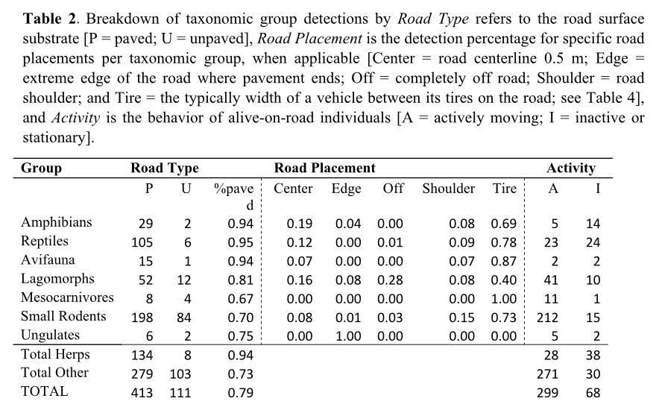
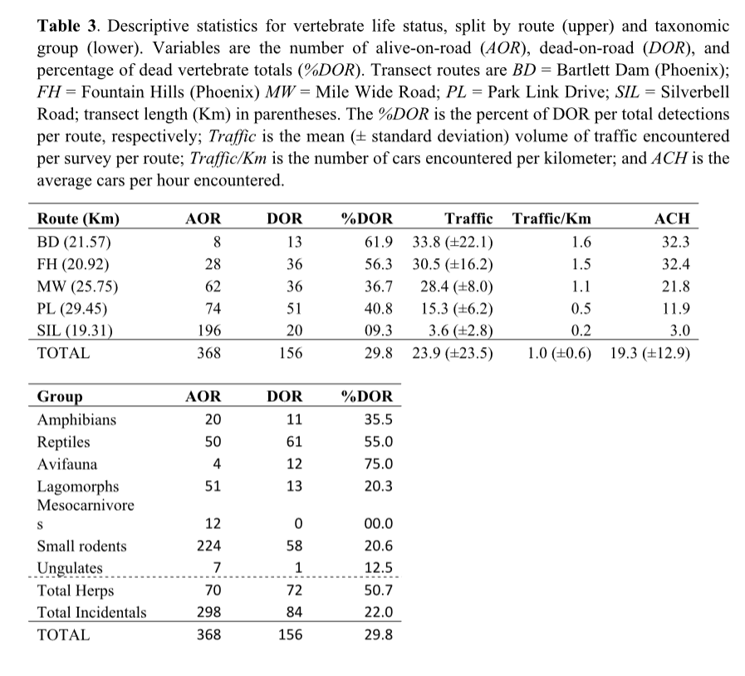

Slide 5
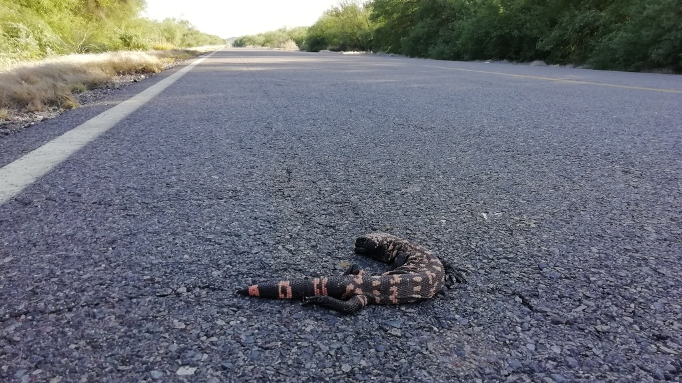
Are Gila Monsters facing these impacts?

Slide 6
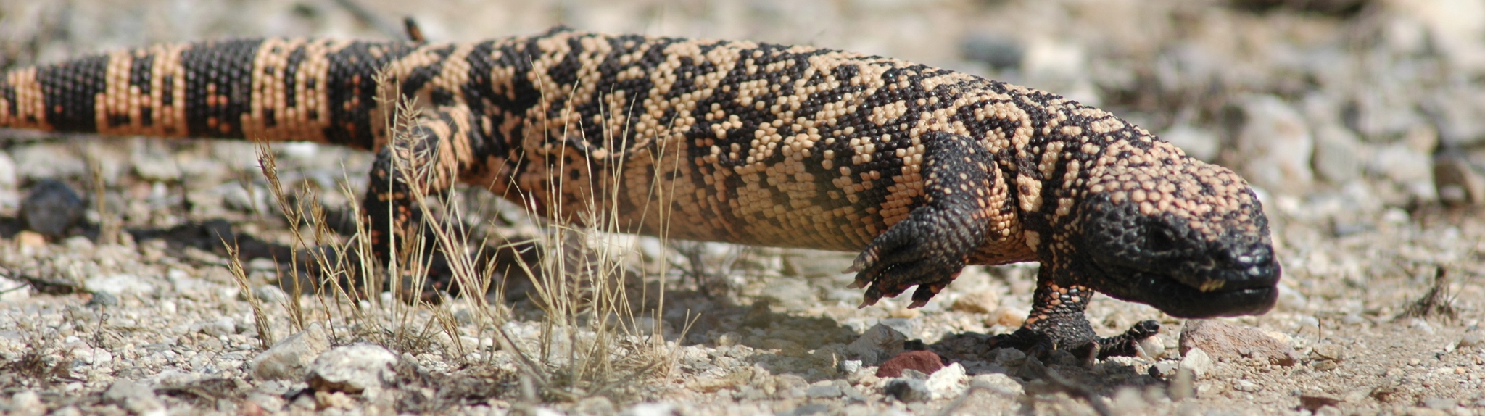

Why Gila Monsters?
Considered threaten by IUCN
Understudied species
Unique squamate – 1 of 2 venomous lizards
venom hormones were perfect model for treating diabetes
Iconic species of the Southwest United States
Geographic range is threatened with increasing urbanization

Slide 7
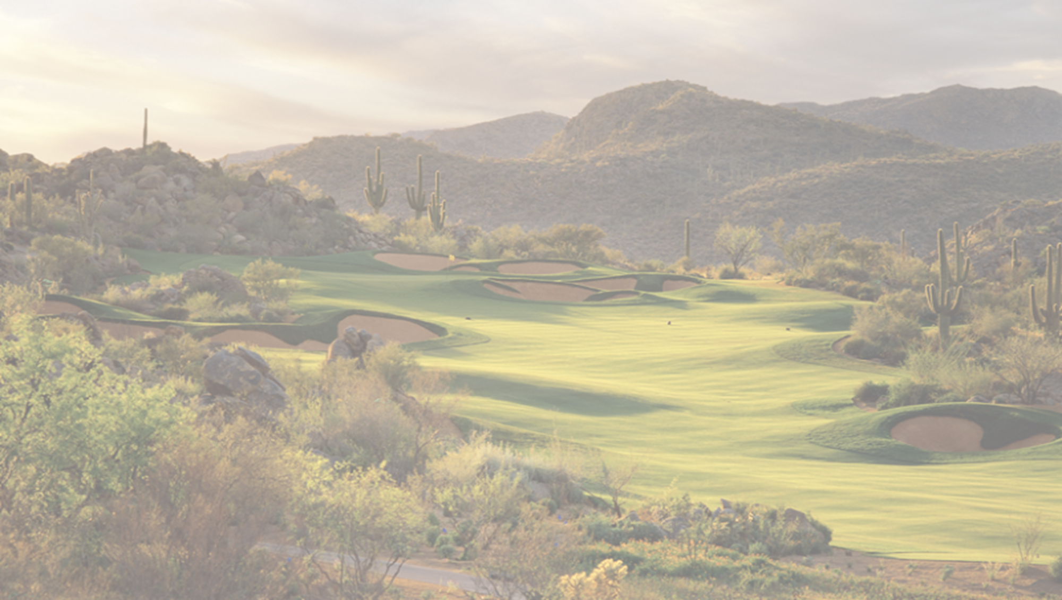
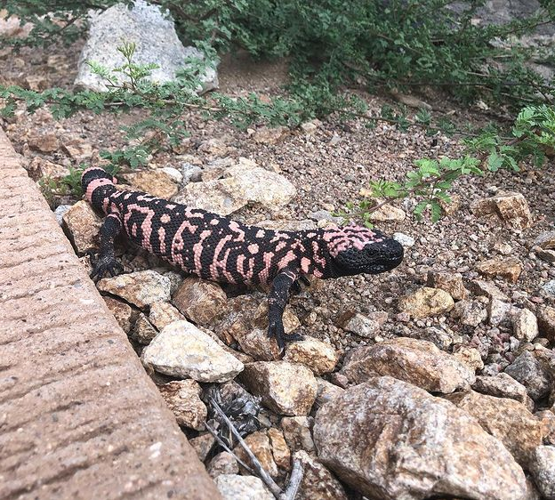
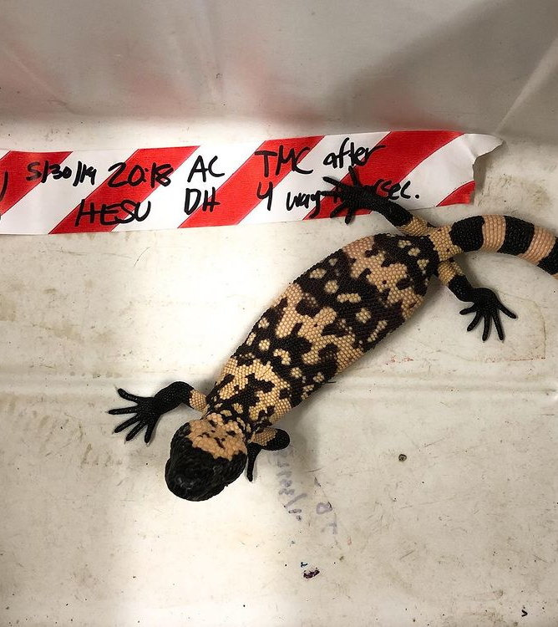
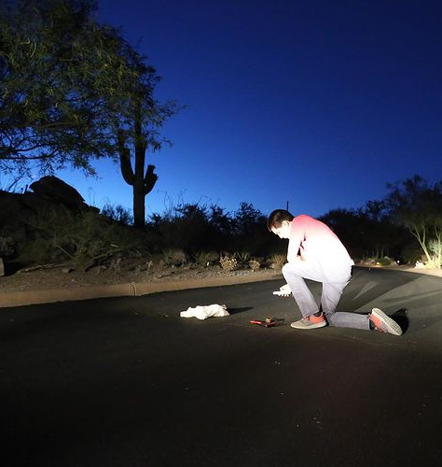
Seasonal Road Surveys and Telemetry
Notes:
Only say we’re looking for snakes and gilas

Slide 8
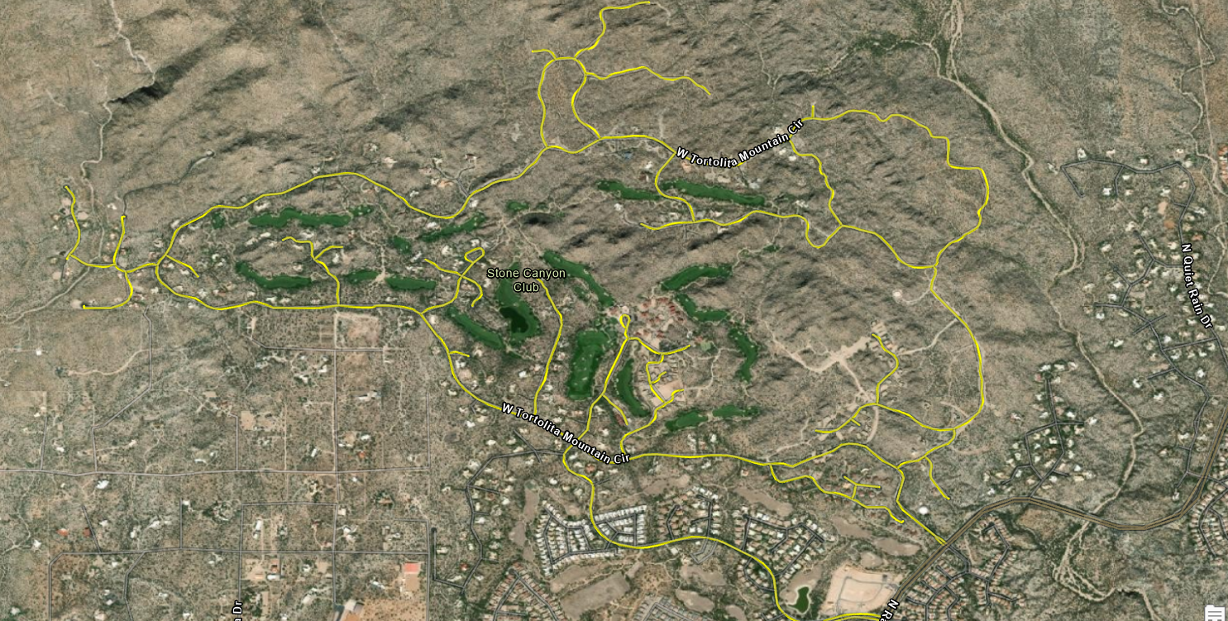
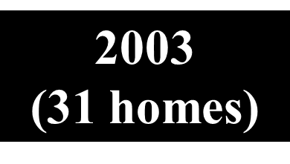
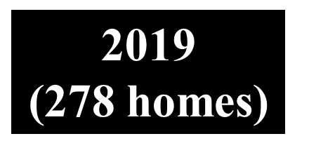
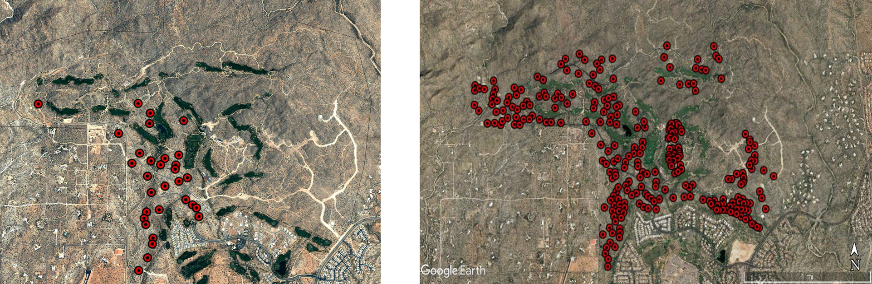
LEGEND
Roads included in surveys- Yellow

Slide 9
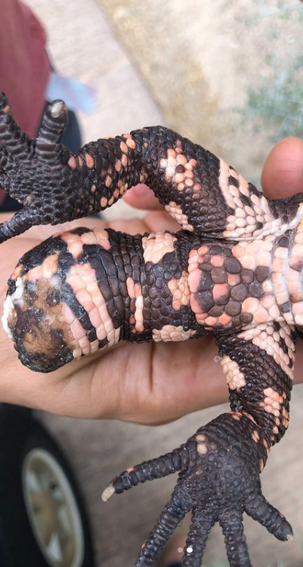
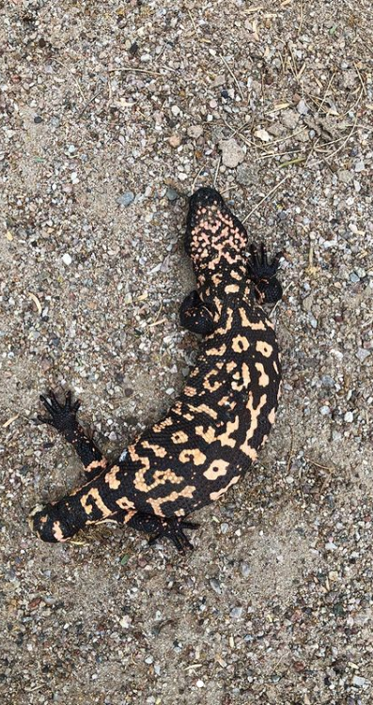
Impacts at the Stone Canyon Study Site
Only 6 DORs (caused by vehicle-animal collisions) recorded since 2002
  Over 400 road surveys conducted since then
  Over 3,300km to find 1 dead Gila Monster

Slide 10
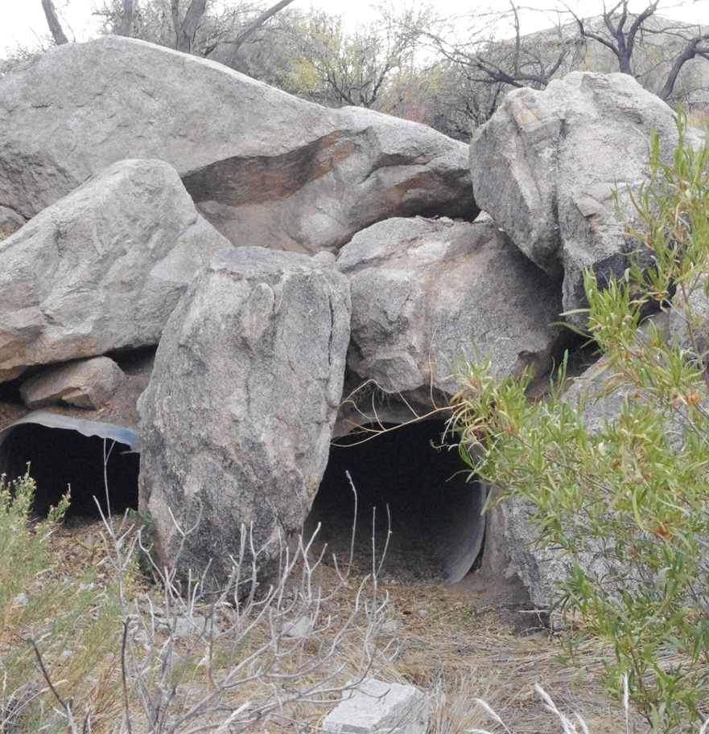
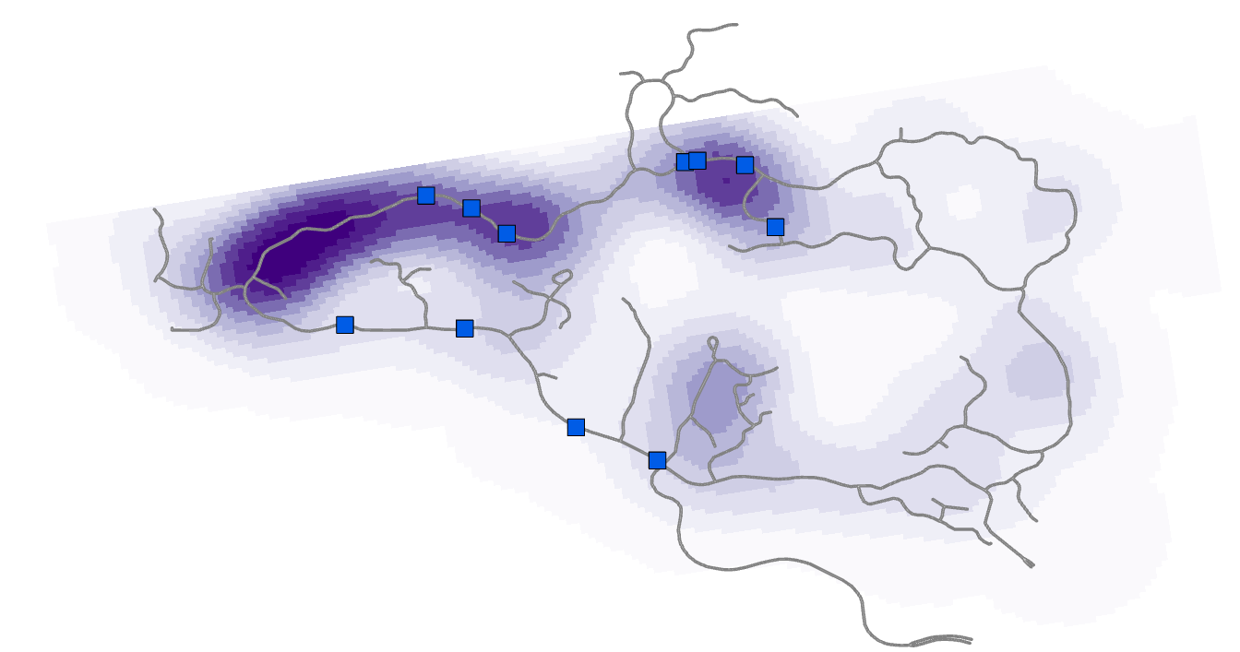
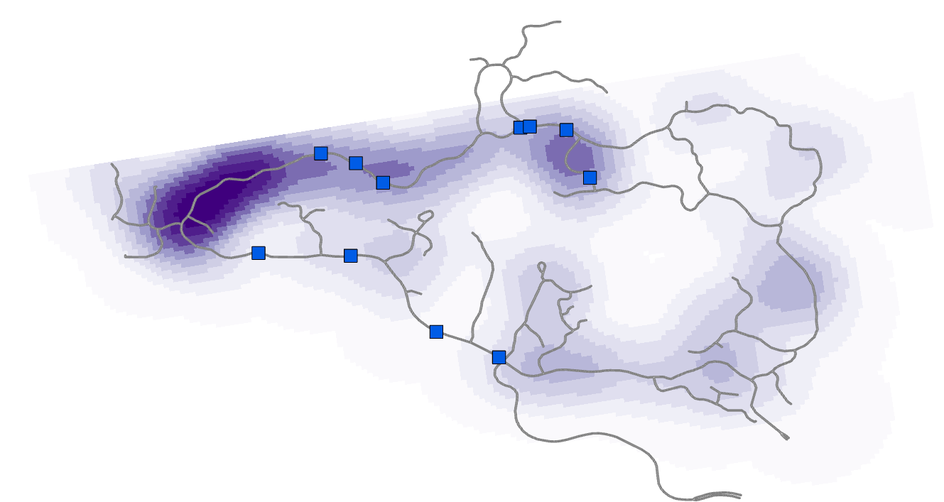
Road Usage in Stone Canyon
Picture 1- Initial Capture, Picture 2- Recapture
Initial Captures
Recaptures
Culverts-
Roads-
Culverts-
Roads-

Slide 11
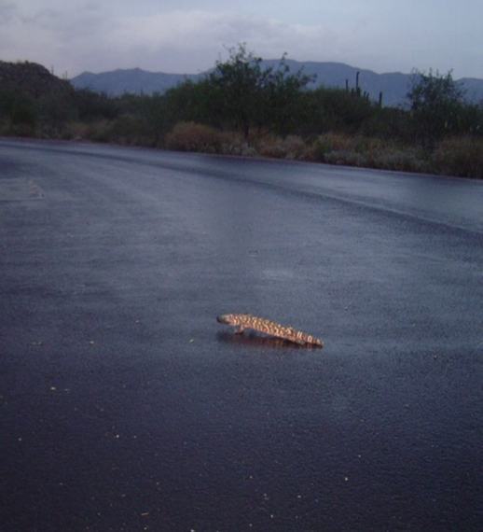
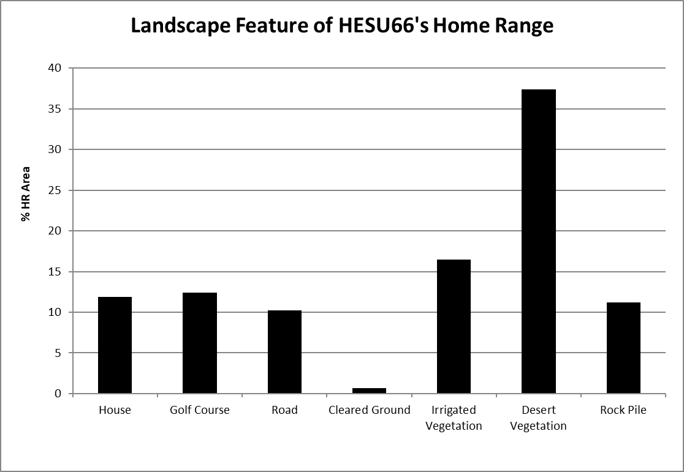

Slide 12
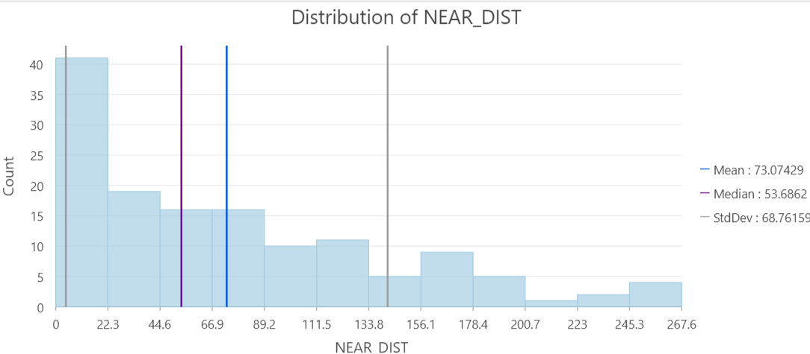
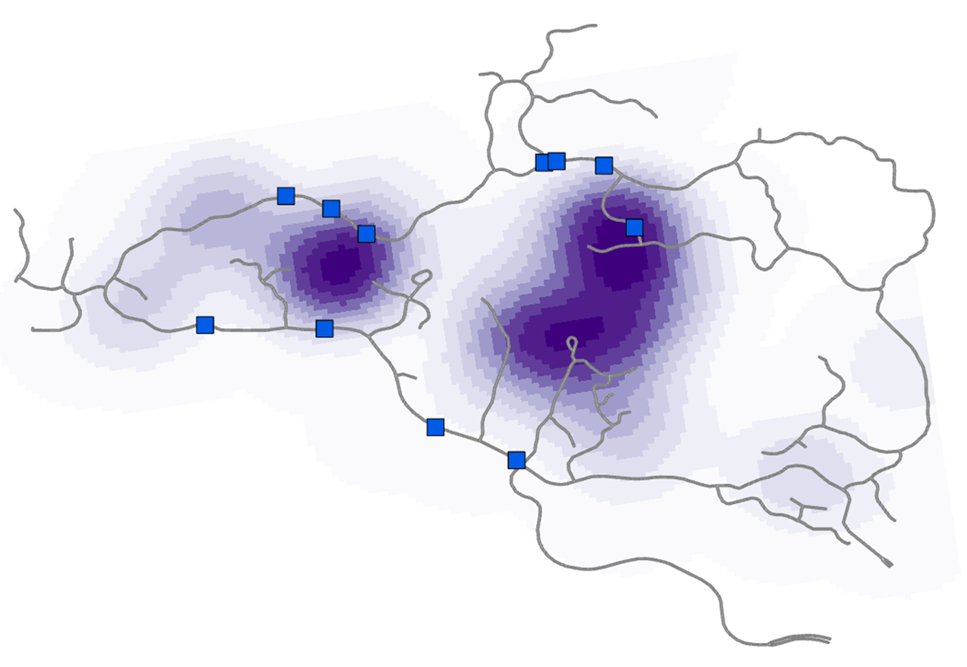

Telemetry Data

Slide 13
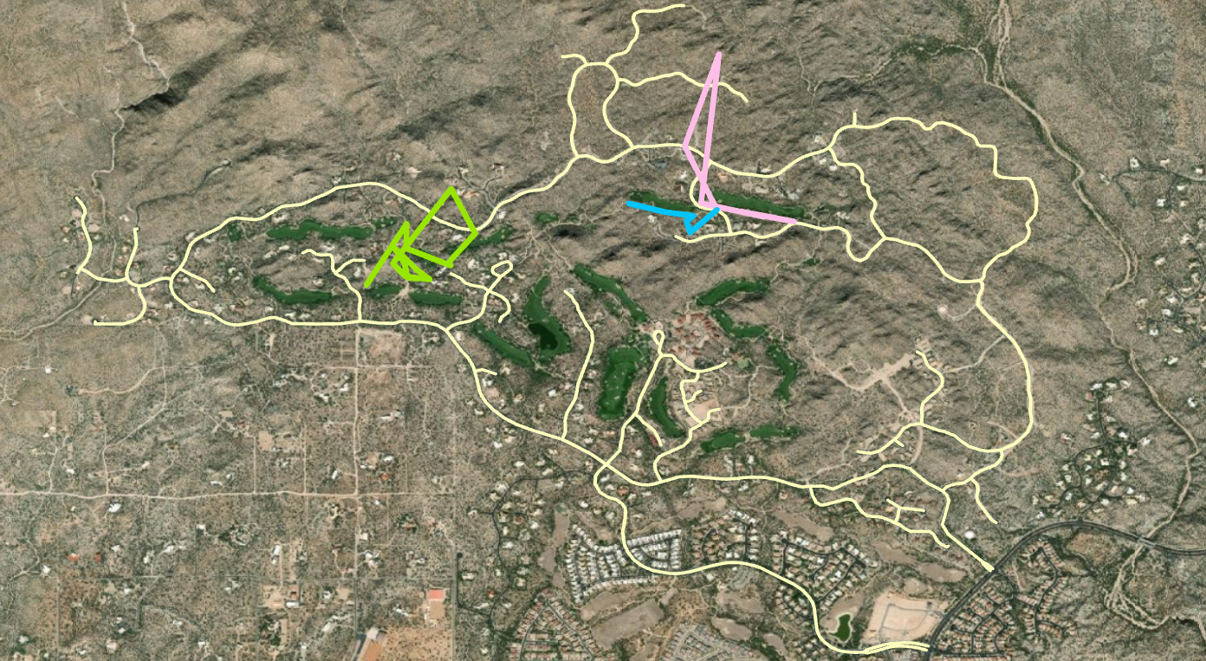
FEMALE HESU’s
HESU #14- Blue
HESU #36- Green
HESU #08- Pink
Notes:
They do cross roads occasionally however they spend most of their time within the golf course area

Slide 14
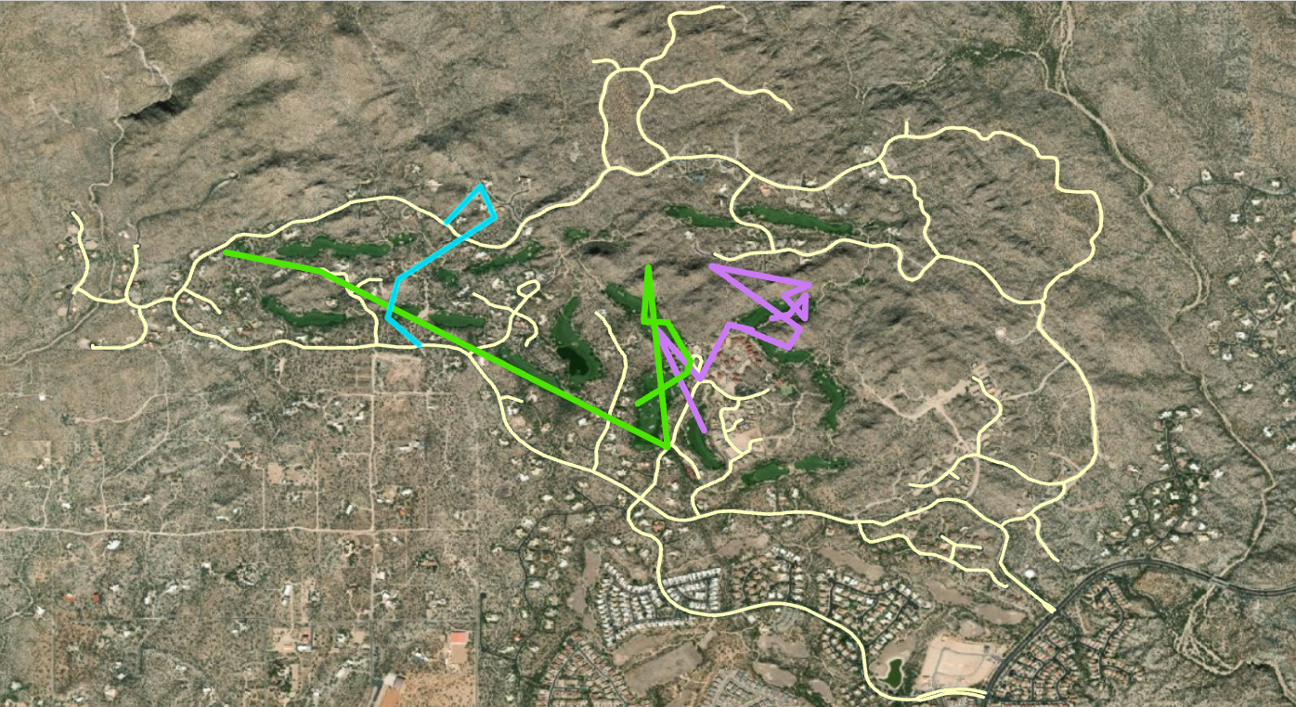
MALE HESU’s
HESU #119- Blue
HESU #69- Green
HESU #45- Purple
Notes:
Add distance averages

Slide 15
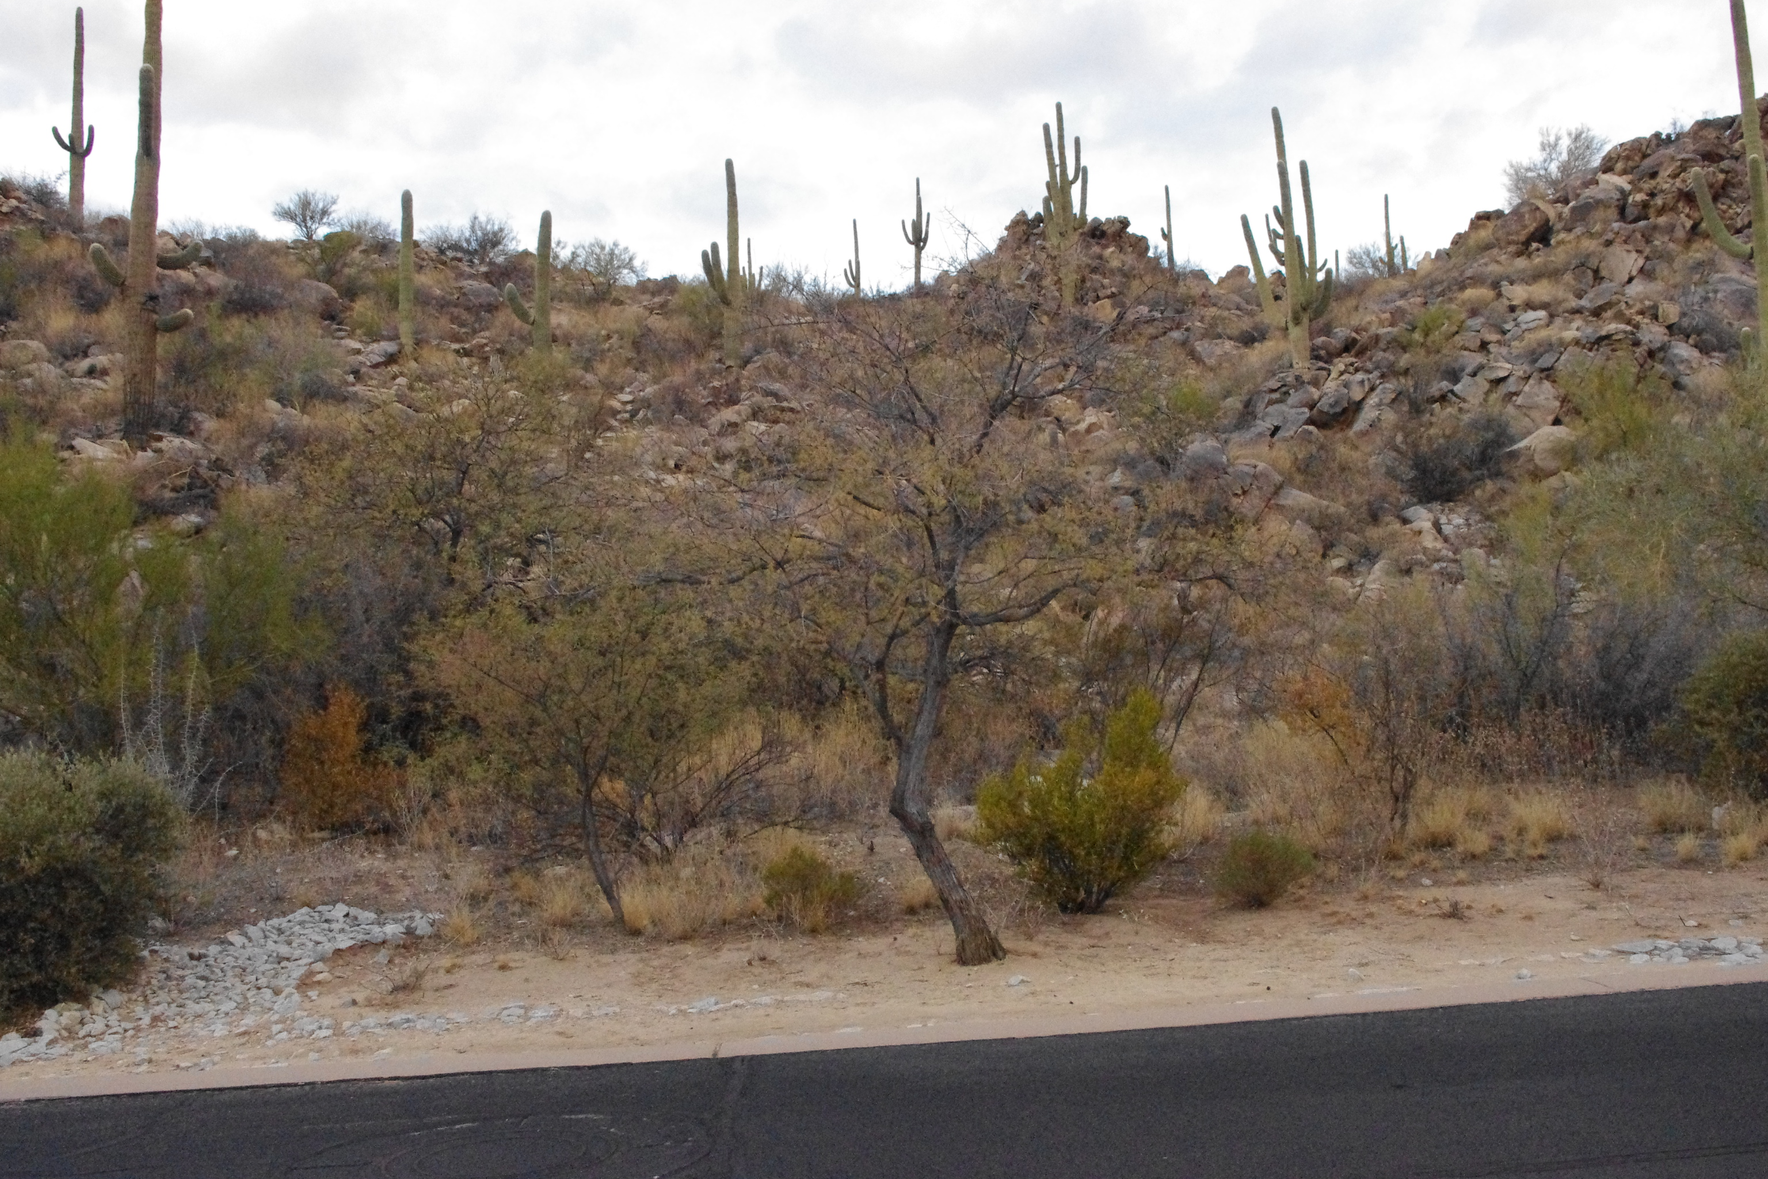
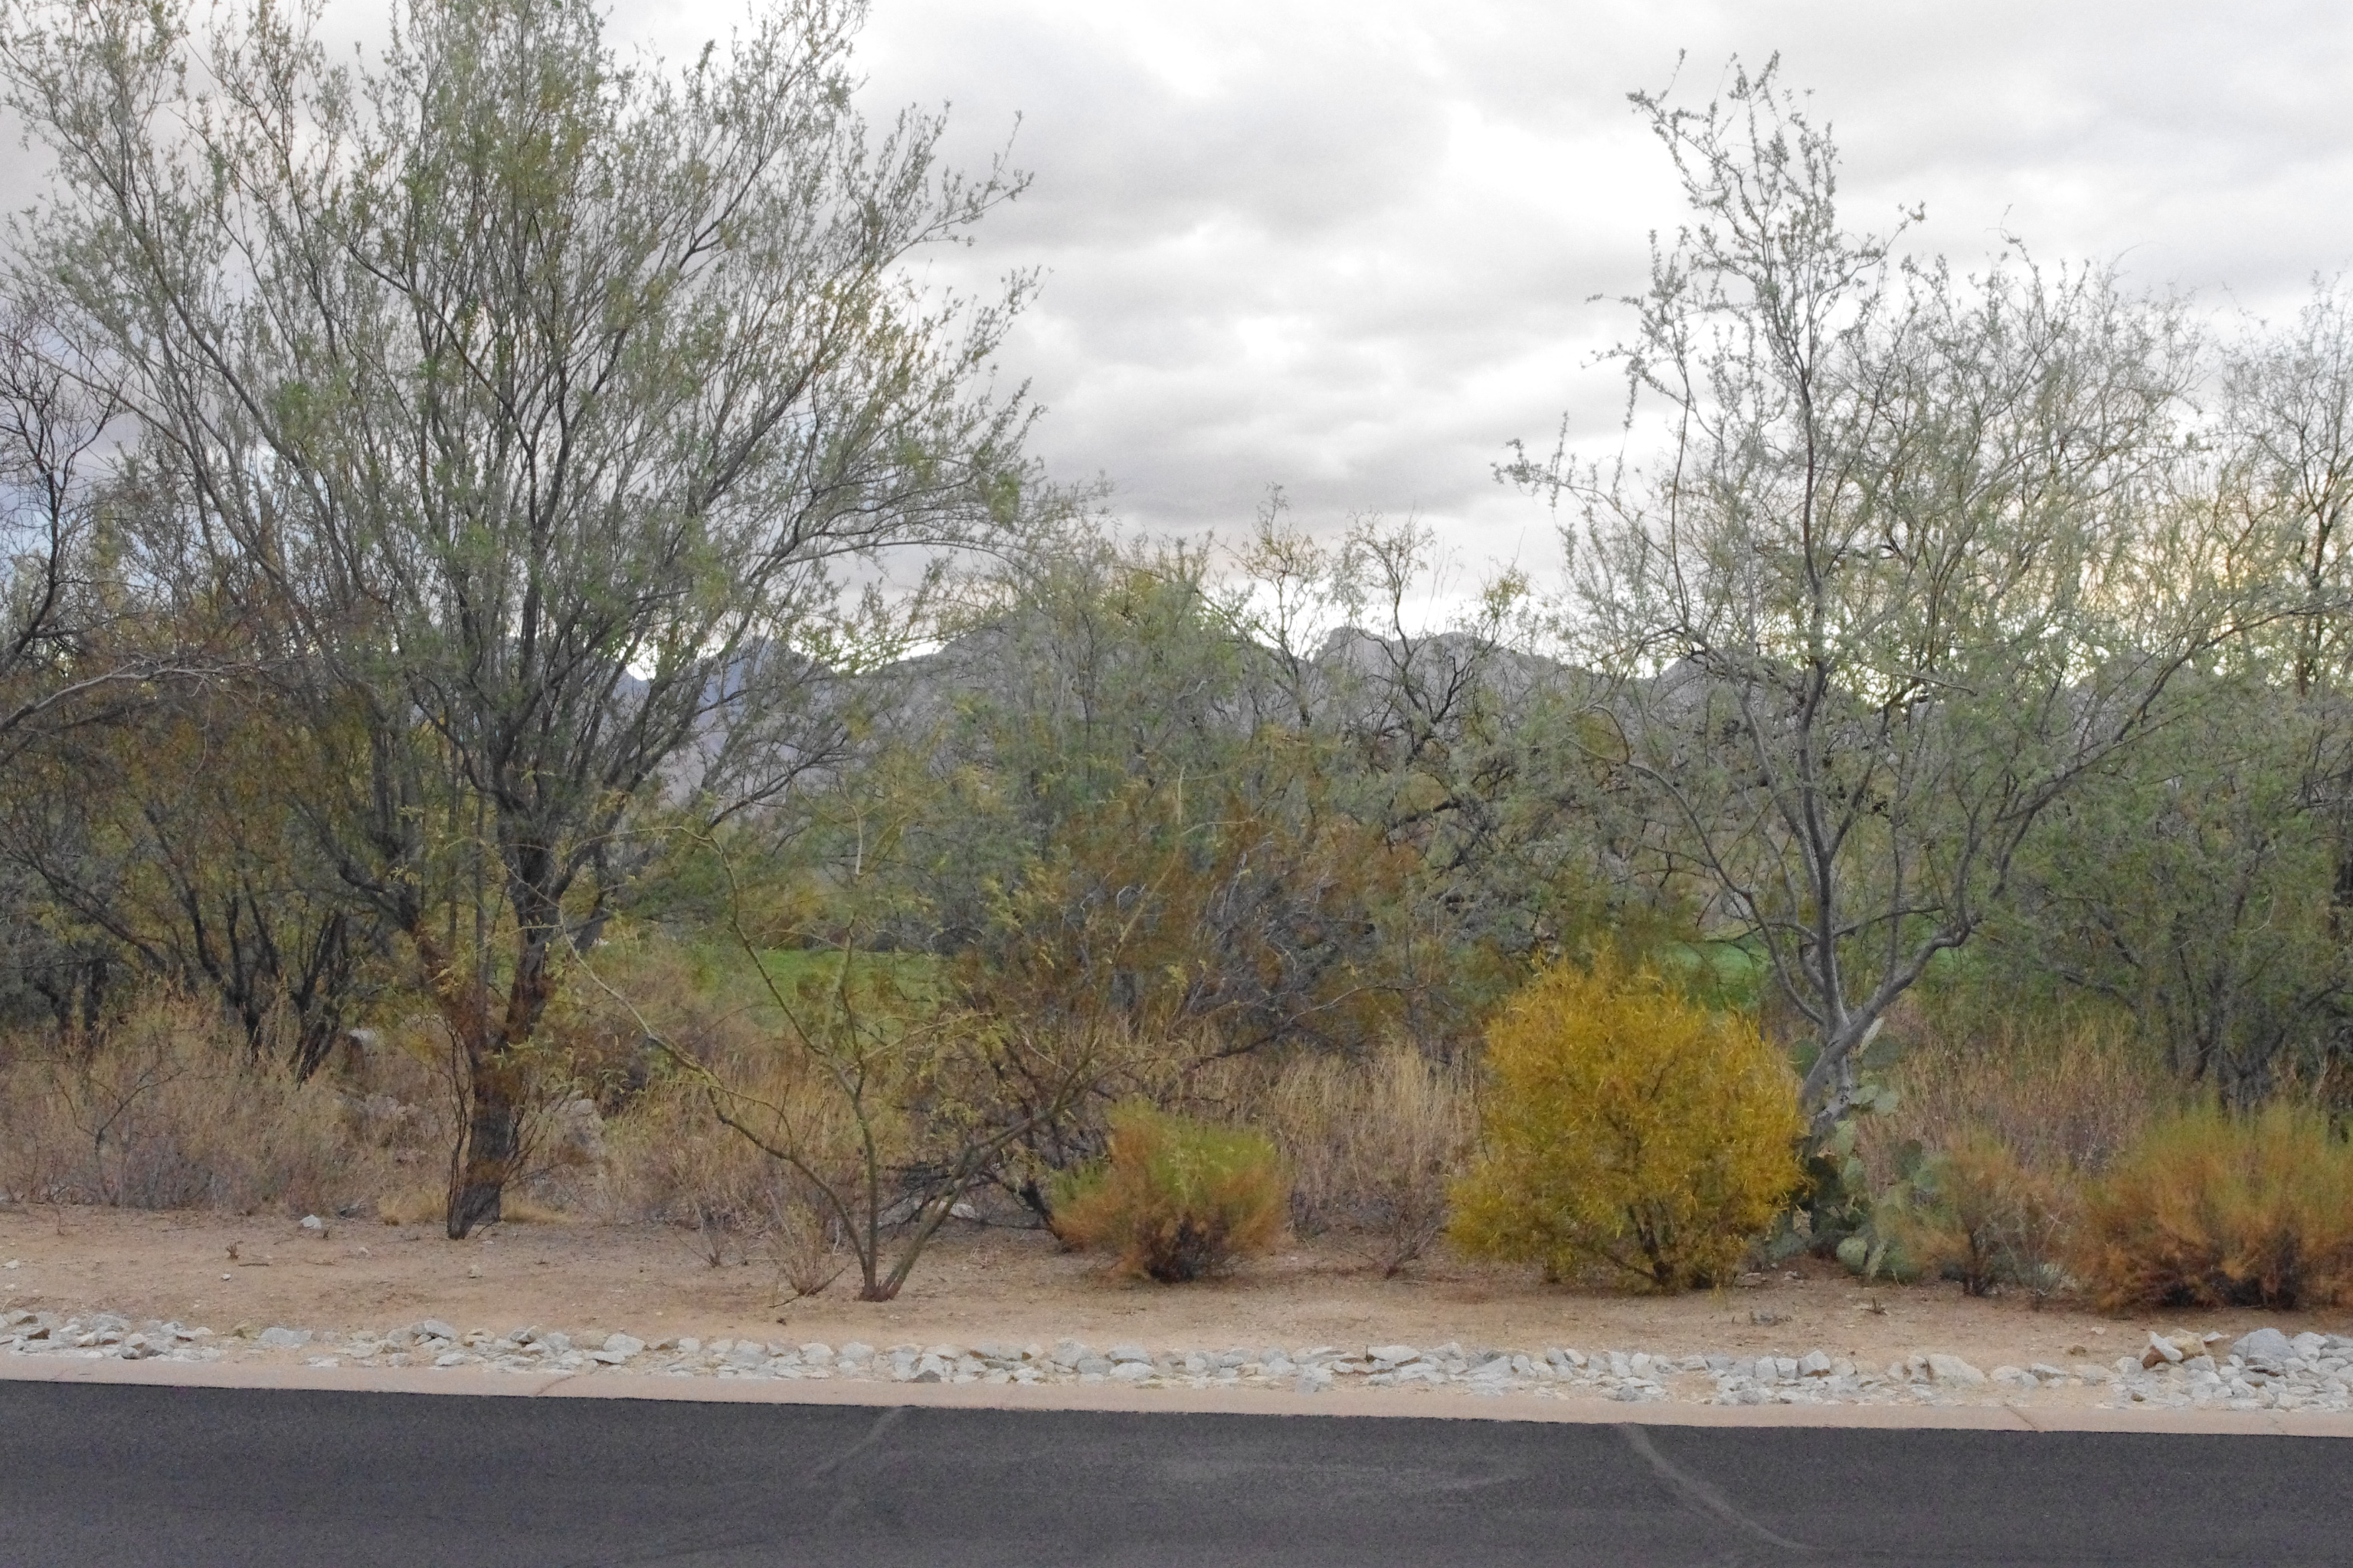

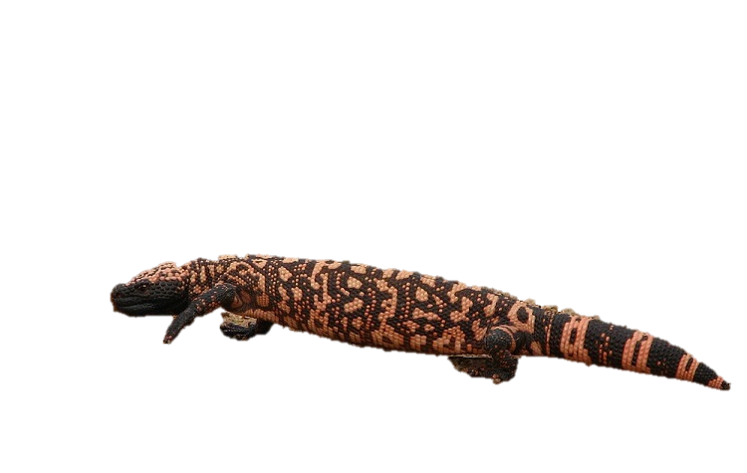
So, we’re left with the question… Why did the Gila Monster cross the road?
Notes:
Text boxes underneath each pic

Slide 16
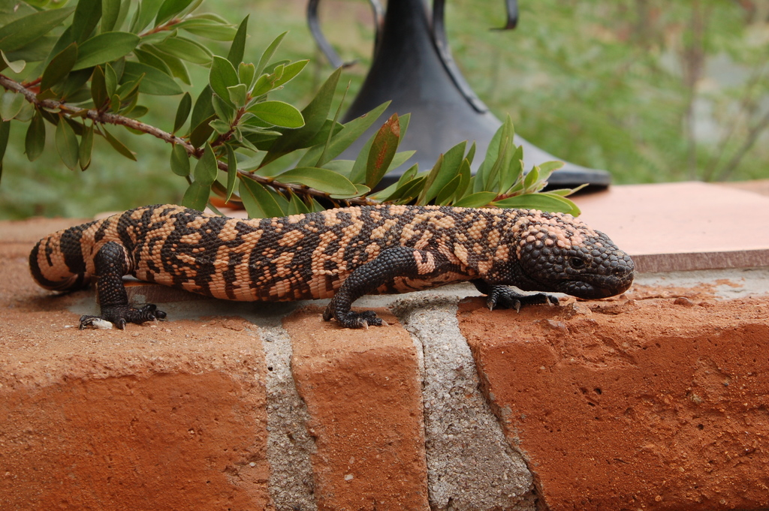
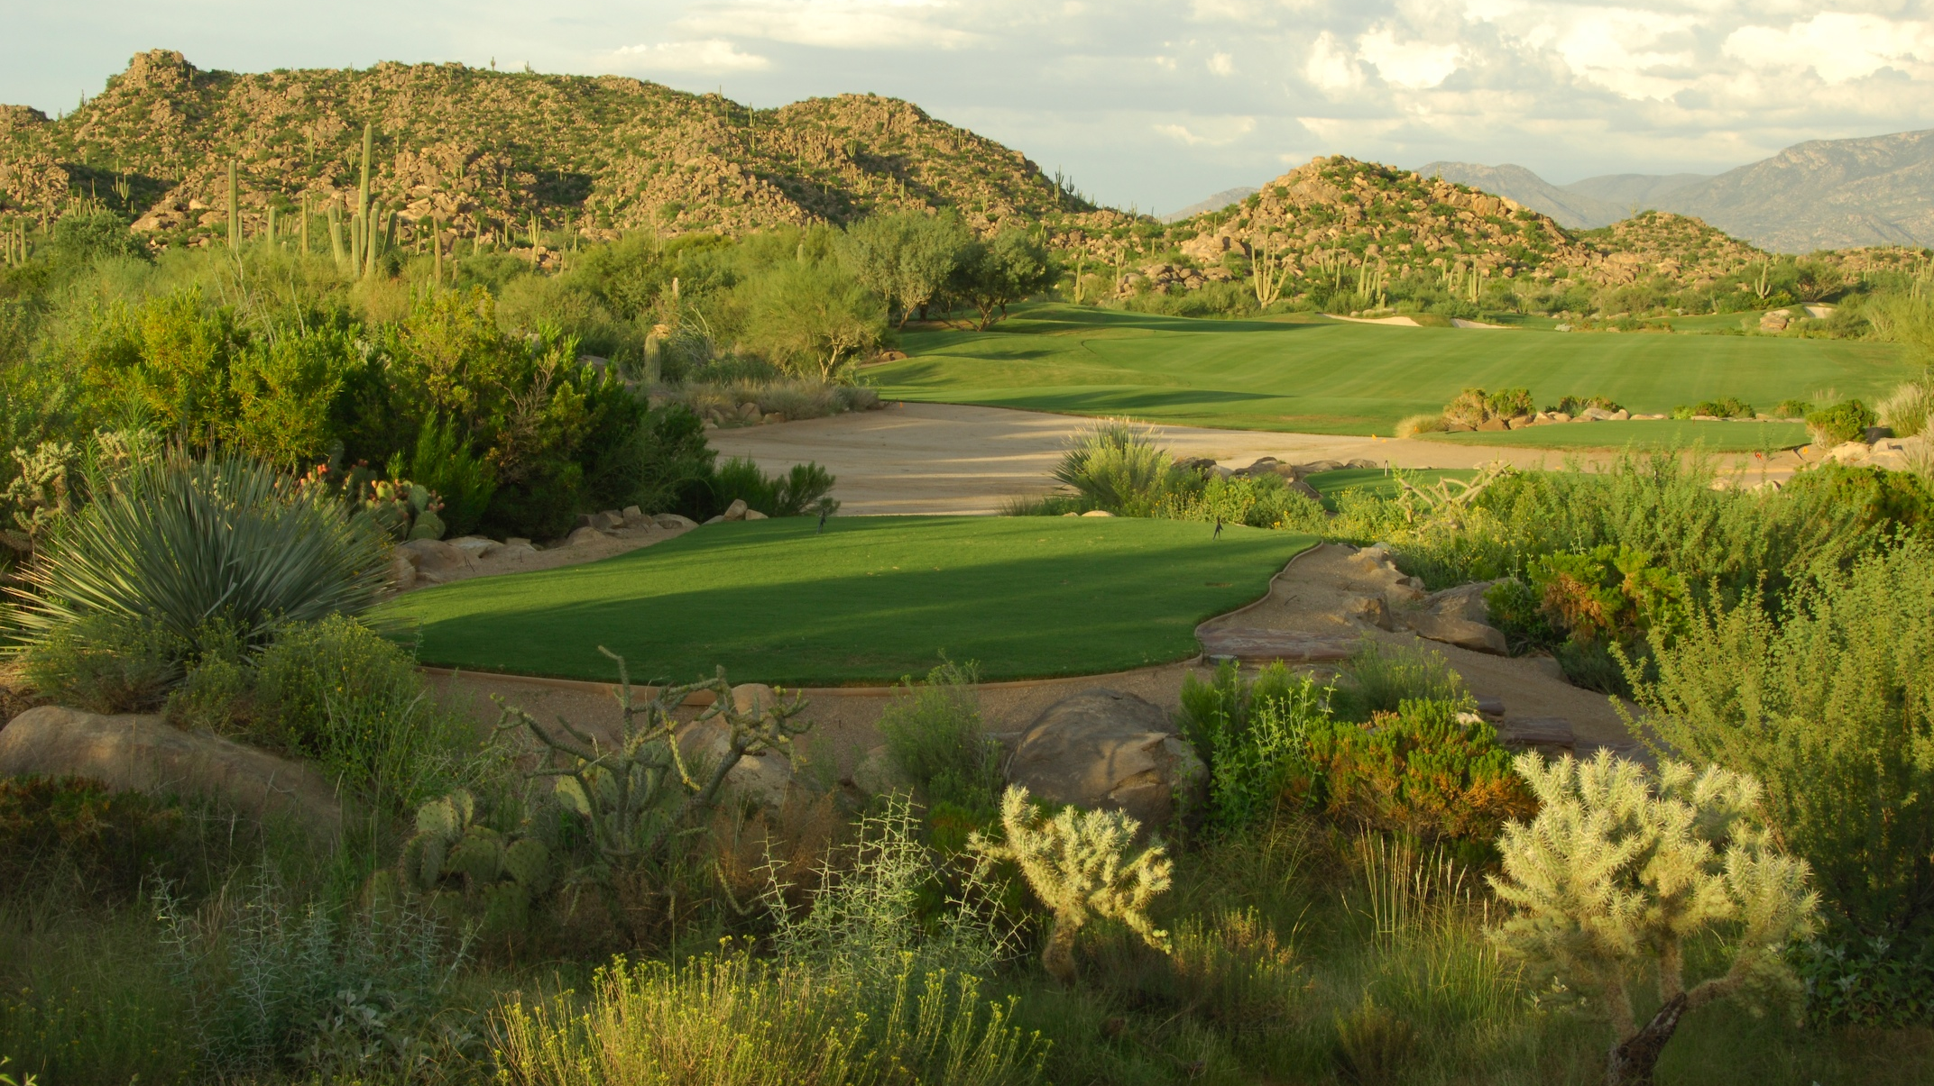

Slide 17
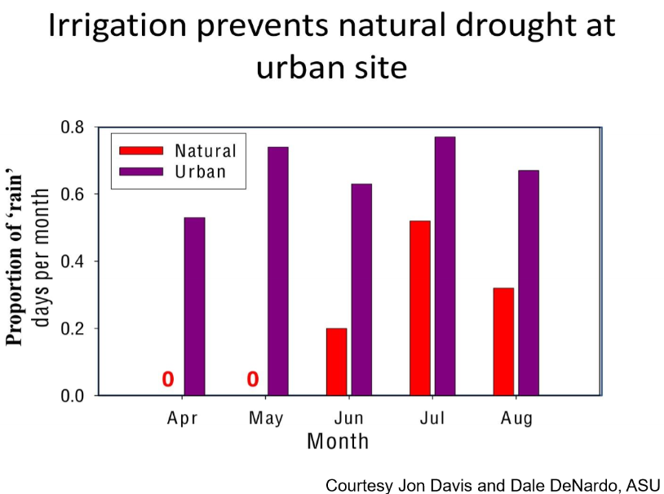

Slide 18
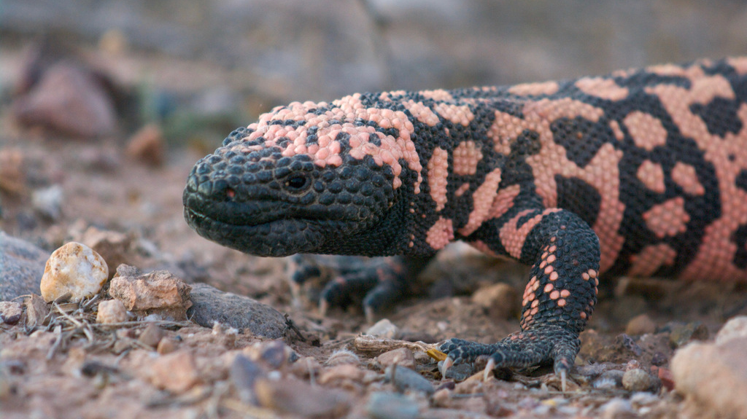
Concluding thoughts
Gila Monsters are facing lower mortality because…
Use of/time on the road
Habitat linkages (culverts)
Prefer to stay in an environment with no natural drought

Slide 19
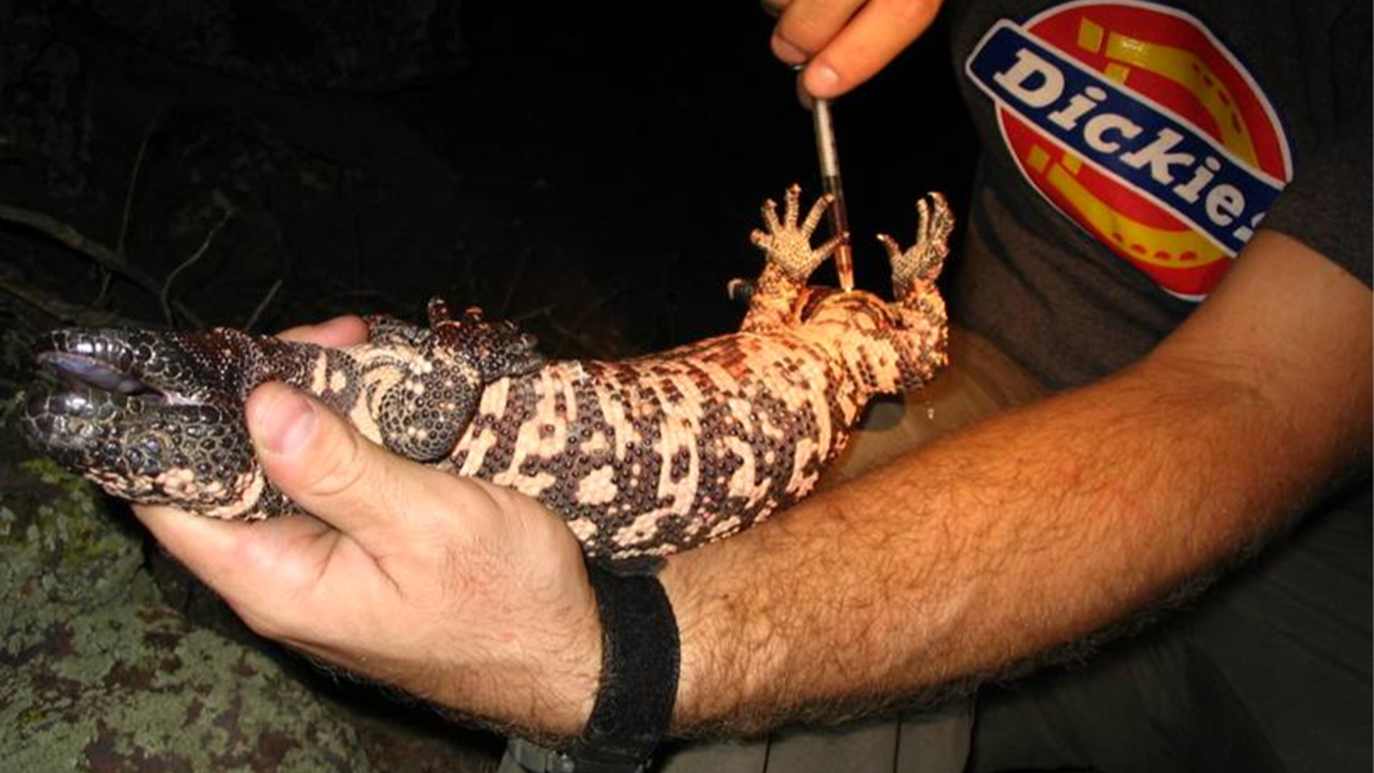
Future projects related to Gila Monsters
Camera traps to confirm use of culverts as habitat linkages
Comparing and dissecting the urban and wild Gila Monster microbiome

Slide 20

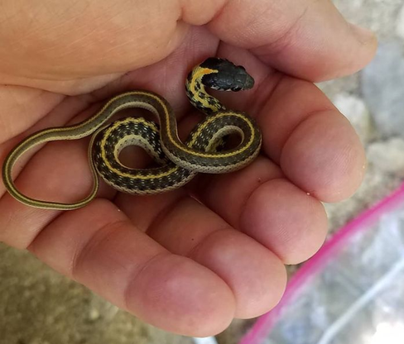


Acknowledgements
NASA Space Grant Consortium
Dr. Matt Goode
Brian Blais
Alexa Komatsu
Diego Huerta
Jon Davis Lab
T&E Inc.
Stone Canyon Neighborhood

Slide 21
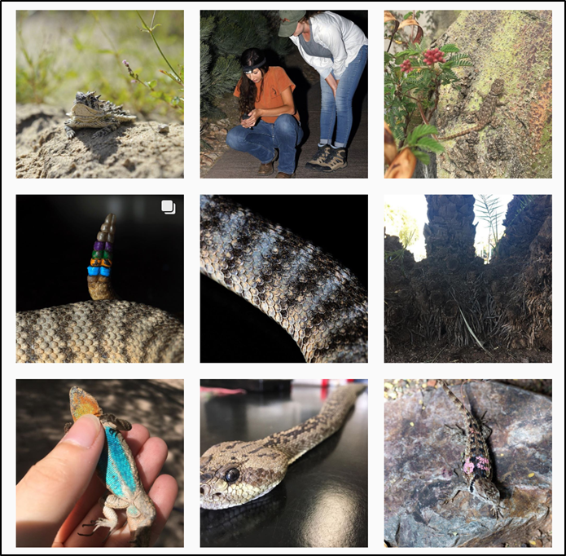
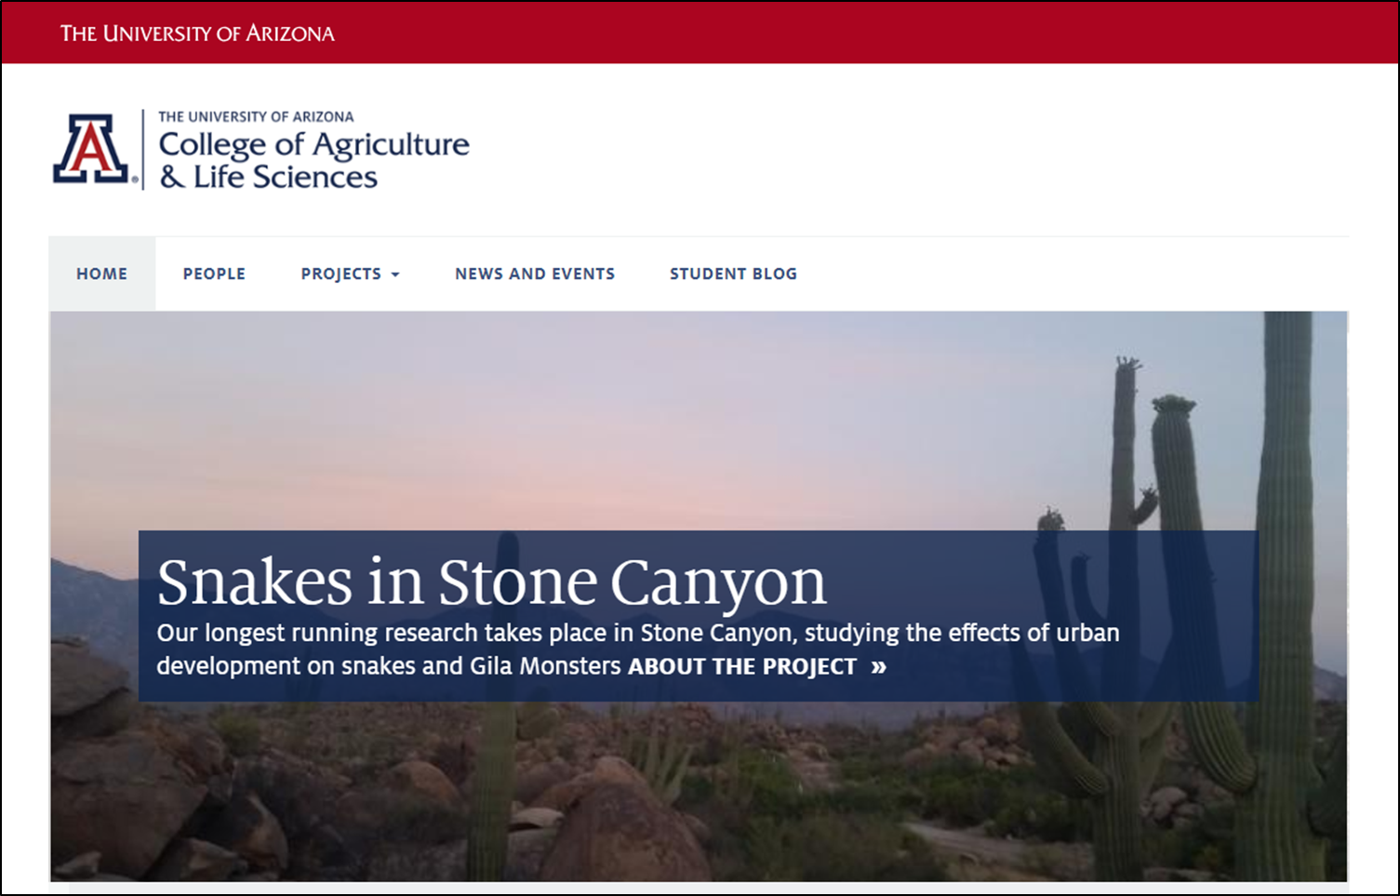


IG: @uaherpetology
FB: uaherpetology
Website: herpetology.arizona.edu

Slide 22
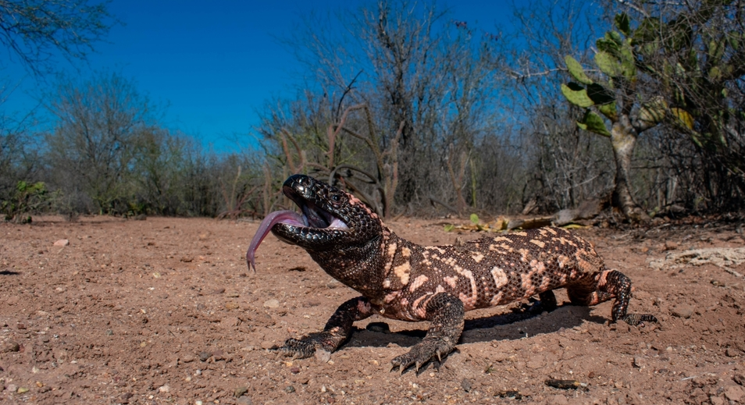
Thank you!

